Slide 1
THROMBECTOMY FOR DISTAL AND MEDIUM VESSEL OCCLUSIONS
ILKCAN COKGOR, MD
STROKE PROGRAM DIRECTOR
MARIN HEALTH MEDICAL CENTER

Slide 2
THROMBECTOMY FOR DISTAL AND MEDIUM VESSEL OCCLUSIONS
Endovascular thrombectomy (EVT) is well established as a highly effective treatment for acute ischemic stroke (AIS) due to proximal, large vessel occlusions (PLVO).
Large artery category includes intracranial internal carotid artery, M1 segment of middle cerebral artery, intracranial vertebral arteries and basilar artery.
Multiple randomized trials demonstrated dramatically improved patient outcomes with EVT among broadly selected patients within first 6 hours and imaging selected patients 6-24 hours after last well known time.
The 6 distal medium arterial arbors are anterior cerebral artery, M2-M4 middle cerebral artery, posterior cerebral artery, posterior inferior cerebellar artery, anterior inferior cerebellar artery, and superior cerebellar artery.
M2 MCA is highly heterogenous across patients. M2 occlusions may occur in dominant segments similar to M1 in size or in nondominant segments similar to M3.

Slide 3
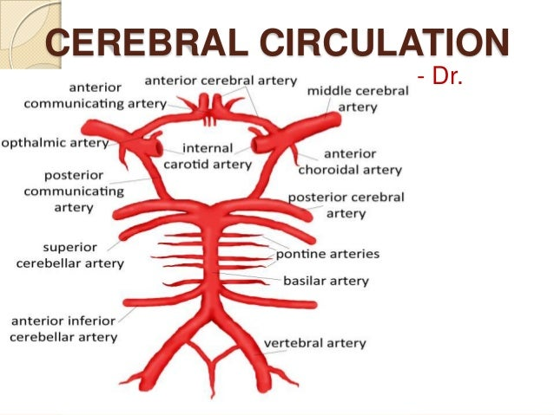

Slide 4
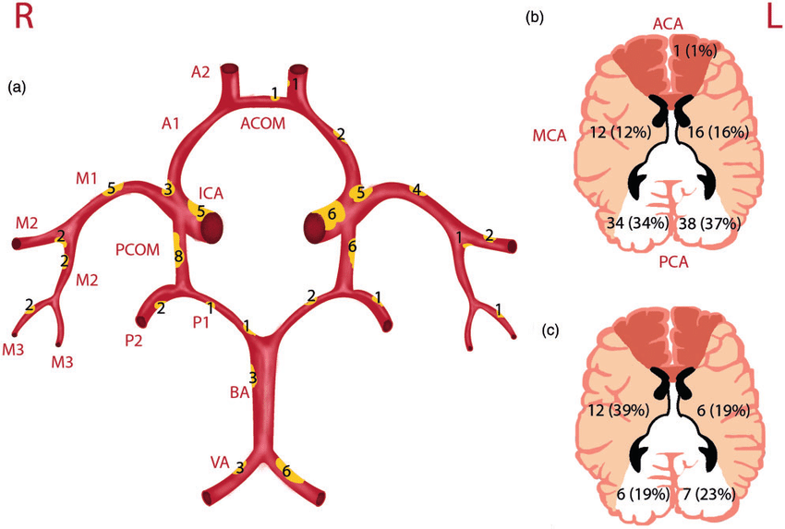

Slide 5
THROMBECTOMY FOR DISTAL AND MEDIUM VESSEL OCCLUSIONS
The distal medium size arteries have 25 anatomic segments and give rise to 34 distinct arterial branches nourishing highly differentiated and superficial cerebral regions.
The intermediate medium sized vessels can be defined as cerebral arteries with lumen diameters between 0.75mm and 2 mm.
The AIS presentations are due to acute PLVOs in 35-40%, acute small vessel occlusions in 20-25%, hemodynamic watershed ischemia in 2-5%, and unusual and disseminated conditions ( reversible vasoconstriction syndrome, hyperviscocity and moyamoya) in 1-5%.
Distal, medium vessel occlusions (DMVO)cause 25-40% of AISs arising as primary thromboemboli or as unintended consequences of EVT performed for PLVOs including emboli to new territories and distal territories within the initially compromised arterial field.

Slide 6
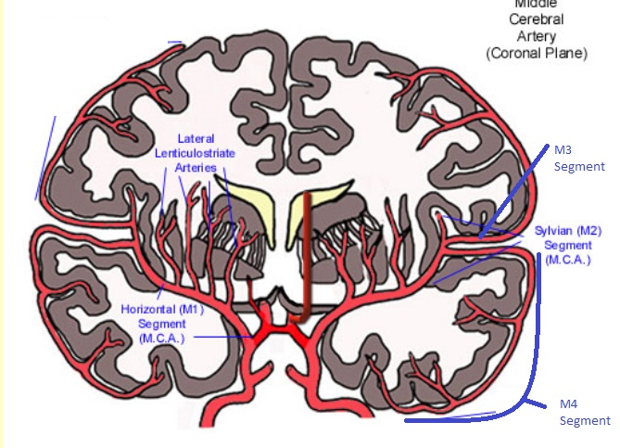

Slide 7
THROMBECTOMY FOR DISTAL AND MEDIUM VESSEL OCCLUSIONS
DMVOs produce frequently disabling neurological symptoms including cognitive, motor, sensory, and visual function subserved by the cortex and superficial white matter.
In CTAs or MRAs distal occlusions are evident as sudden vessel cutoffs. They detect M2 MCA, A1 ACA, P1 PCA and proximal cerebellar artery occlusions with high accuracy.
Detection of distal occlusions is aided by CTA/MRA acquisitions that continue late into the passage of contrast through the cerebral vasculature including multiphase rather than single phase CTA and time resolved MRA.
Perfusion imaging is helpful in indicating indirectly presence of DMVOs. Hypoperfusion in a wedge shaped region matching the typical territory of an ACA, MCA, PCA or cerebellar distal branch artery strongly suggests occlusion of the feeding vessel.

Slide 9
THROMBECTOMY FOR DISTAL AND MEDIUM VESSEL OCCLUSIONS
INTERRSECT study showed IV alteplase before endovascular intervention recanalized 43% of M3 MCA, ACA or PCA occlusions, and 37% of M2 MCA compared to 22% for M1 MCA and 11% for ICA.
Several studies evaluated intra arterial lysis as a primary therapy for DMVOs.
While IV fibrinolytics are more effective for distal than proximal occlusions they fail to recanalize1/2 to 2/3rds of DMVOs.
DMVO are longer, tortuous and have thinner walls which potentially increase risk of dissection, perforation and vasospasm. However their strategic locations can be debilitating.
Early clinical studies using recently available, smaller, more navigable stent retriever and thromboaspiration devices suggest EVT for DMVOs is safe, technically efficacious, and potentially beneficial.
Collaborative investigations are desirable to enhance imaging recognition of DMVOs, advance design and technical efficacy, conduct large, rapid clinical trials to use EVT to restore cerebral perfusion is now the new target.

Slide 10
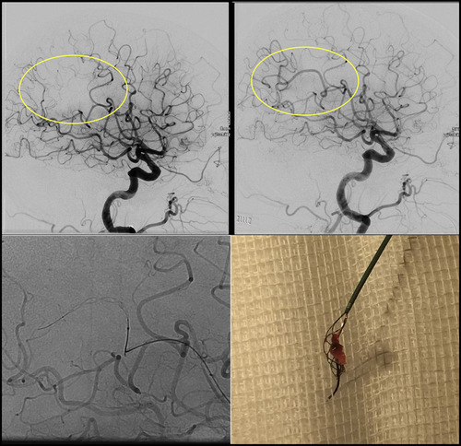
THROMBECTOMY FOR DISTAL AND MEDIUM VESSEL OCCLUSIONS
Distal medium vessel occlusion reperfusion by stent retriever. Upper left, Following endovascular thrombectomy for an M1 middle cerebral artery (MCA) occlusion, angiography showed a residual or new distal M4 MCA branch occlusion (yellow circle). Upper right, Reperfusion of M4 after distal thrombectomy procedure (yellow circle). Lower left, Tiger 13 stent retriever advanced through Headway27 microcatheter into target branch artery. Lower right, Retrieved thrombus. Image courtesy of Rene Chapot, MD.

Slide 11
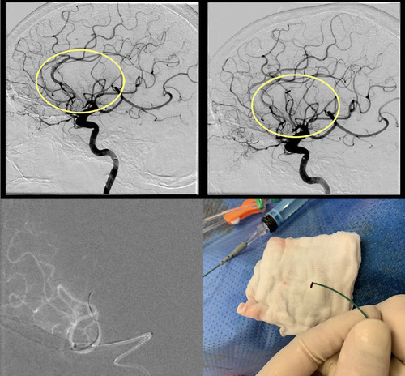
THROMBECTOMY FOR DISTAL AND MEDIUM VESSEL OCCLUSIONS
Distal medium vessel occlusion reperfusion by endovascular thromboaspiration. Upper left, Initial angiography showed a primary cardioembolic M3 middle cerebral artery branch occlusion (yellow circle). Upper right, Reperfusion at the end of distal thrombectomy procedure (yellow circle). Lower left, Headway27 microcatheter advanced into target branch artery. Lower right, Retrieved thrombus. Image courtesy of Dan Meila, MD.

