Slide 1
BRILINTA VERSUS PLAVIX
(Ticagrelor versus clopidogrel)
ILKCAN COKGOR, MD
MARIN HEALTH STROKE PROGRAM

Slide 2
THALES TRIAL
TICAGRELOR AND ASPIRIN OR ASPIRIN ALONE IN ACUTE ISCHEMIC STROKE OR TIA
JULY 16,2020

Slide 3
TICAGRELOR AND ASPIRIN OR ASPIRIN ALONE IN ACUTE ISCHEMIC STROKE OR TIA
Randomized, placebo controlled, double blind trial
Patients had either mild to moderate acute non cardioembolic ischemic stroke with NIHSS score of 5 or less or TIA
Patients were assigned within 24 hours after symptom onset:
Ticagrelor 180mg loading dose followed by 90mg BID plus ASA 300-325mg on the first day followed by 75-100mg daily for 30 days
Matching placebo plus ASA
Primary outcome was a composite of stroke or death within 30 days
Secondary outcomes were first subsequent ischemic stroke and incidence of disability within 30 days
Primary safety outcome was severe bleeding

Slide 4
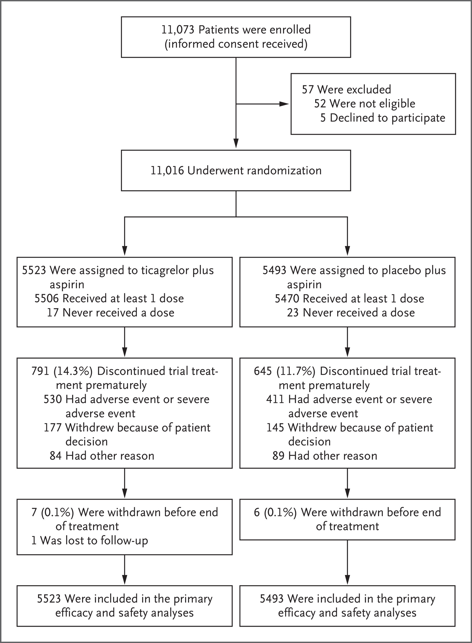

Slide 5
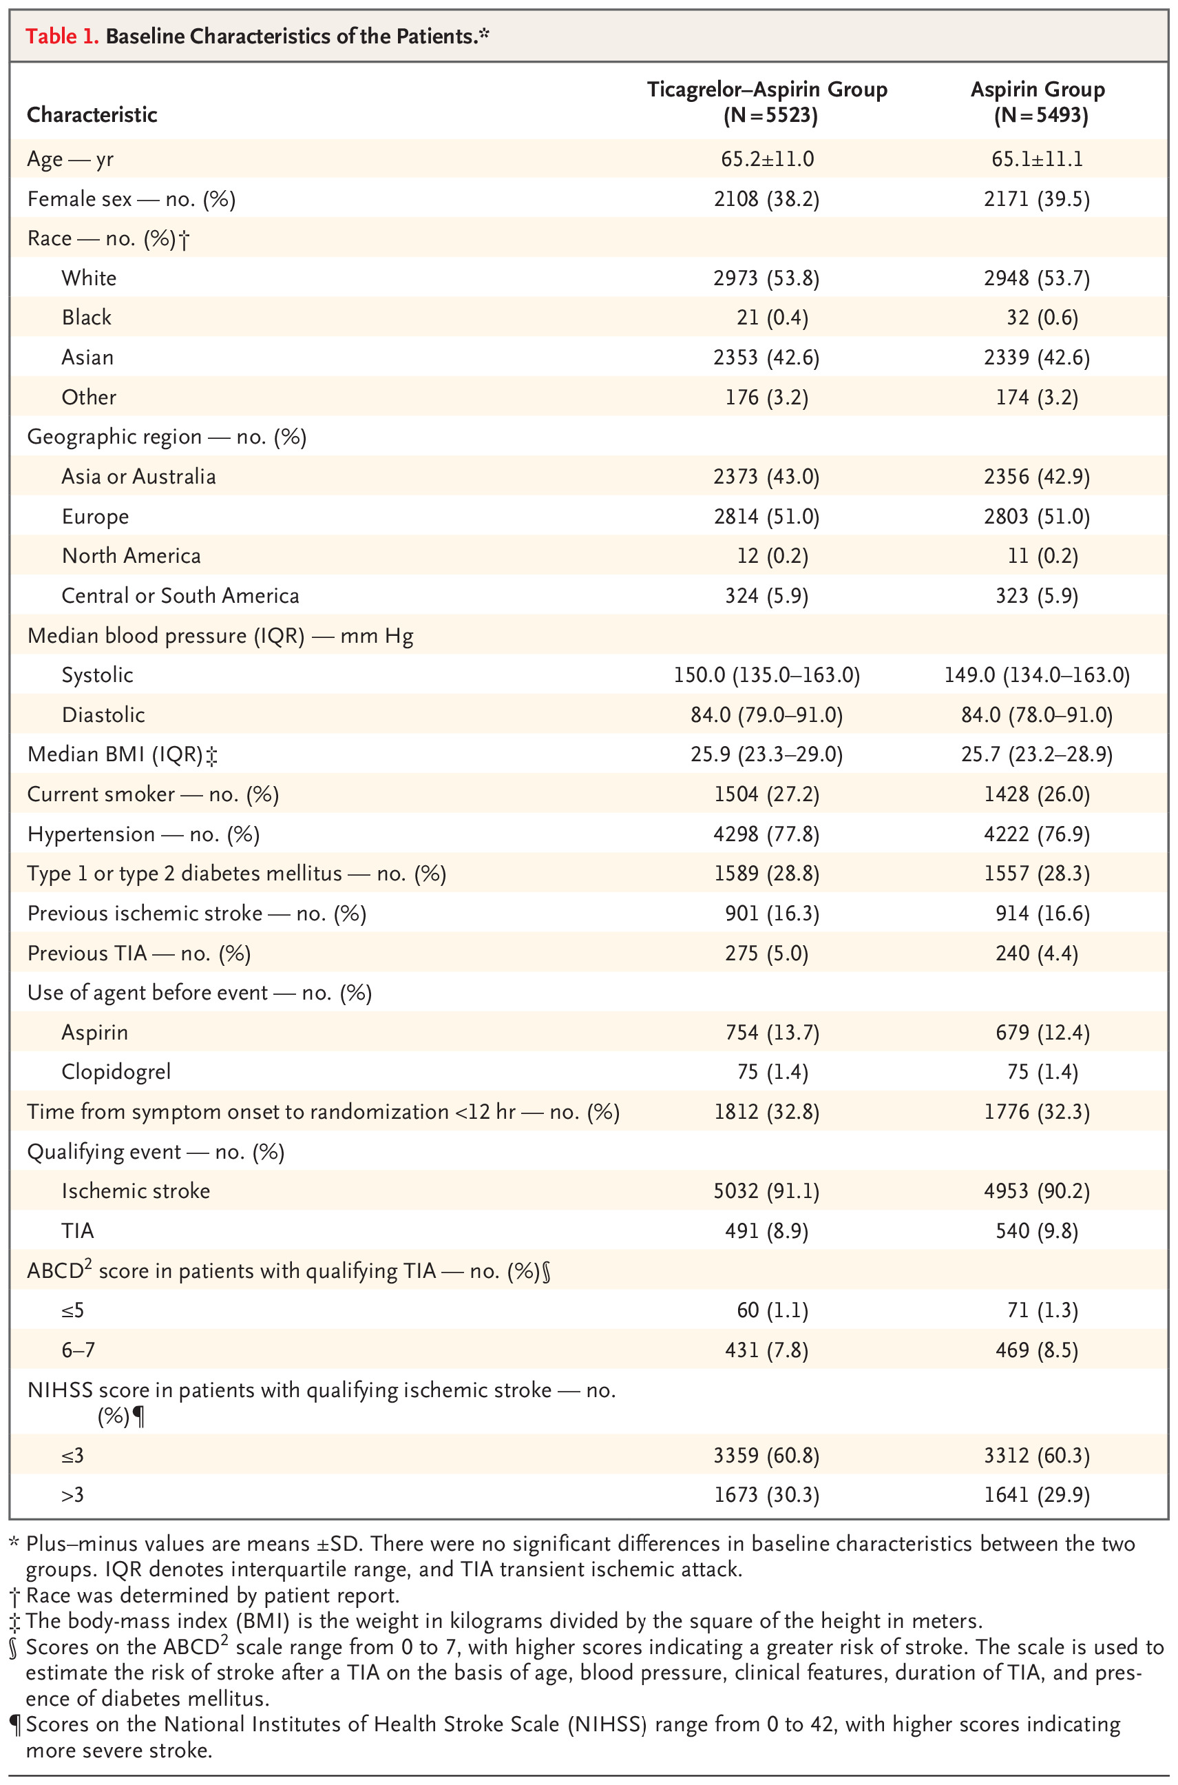

Slide 6
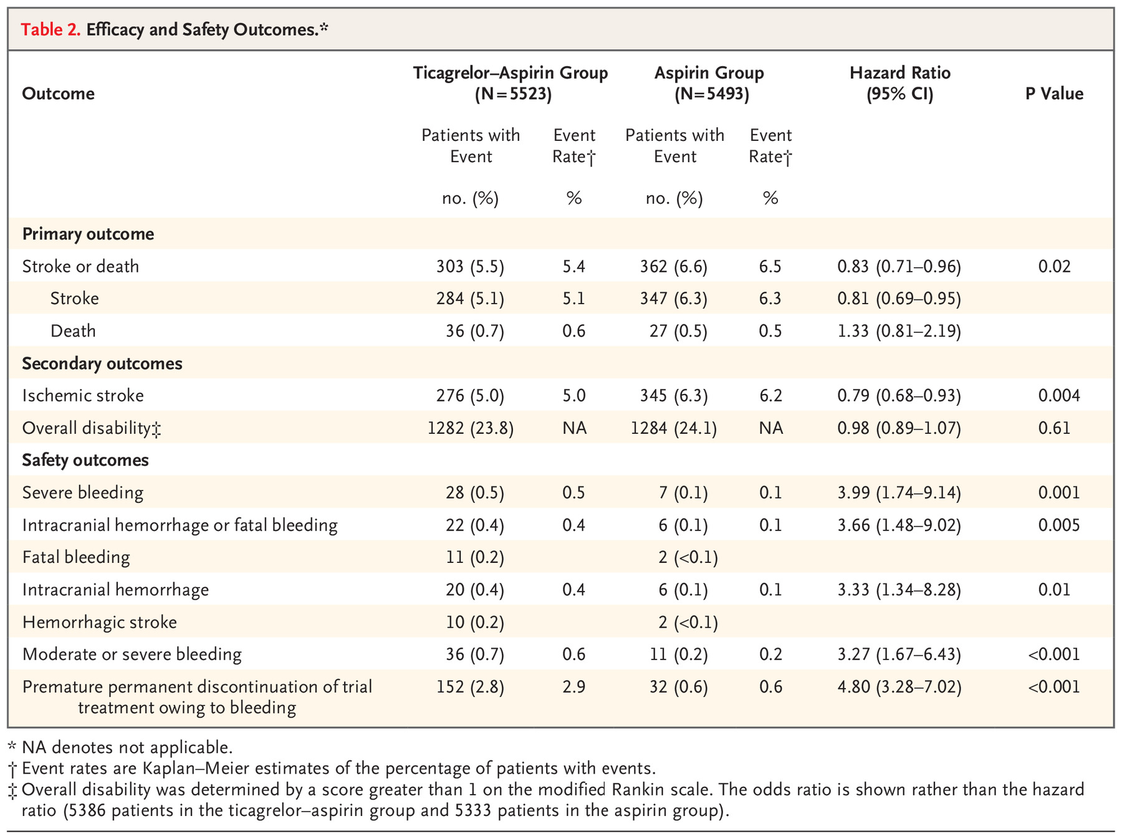
Table 2. Efficacy and Safety Outcomes.*
Outcome | Ticagrelor–Aspirin Group (N=5523) |  | Aspirin Group (N=5493) |  | Hazard Ratio (95% CI) | P Value
 | Patients with Event | Event Rate† | Patients with Event | Event Rate†
 | no. (%) | % | no. (%) | %
Primary outcome
Stroke or death | 303 (5.5) | 5.4 | 362 (6.6) | 6.5 | 0.83 (0.71–0.96) | 0.02
Stroke | 284 (5.1) | 5.1 | 347 (6.3) | 6.3 | 0.81 (0.69–0.95)
Death | 36 (0.7) | 0.6 | 27 (0.5) | 0.5 | 1.33 (0.81–2.19)
Secondary outcomes
Ischemic stroke | 276 (5.0) | 5.0 | 345 (6.3) | 6.2 | 0.79 (0.68–0.93) | 0.004
Overall disability‡ | 1282 (23.8) | NA | 1284 (24.1) | NA | 0.98 (0.89–1.07) | 0.61
Safety outcomes
Severe bleeding | 28 (0.5) | 0.5 | 7 (0.1) | 0.1 | 3.99 (1.74–9.14) | 0.001
Intracranial hemorrhage or fatal bleeding | 22 (0.4) | 0.4 | 6 (0.1) | 0.1 | 3.66 (1.48–9.02) | 0.005
Fatal bleeding | 11 (0.2) |  | 2 (<0.1)
Intracranial hemorrhage | 20 (0.4) | 0.4 | 6 (0.1) | 0.1 | 3.33 (1.34–8.28) | 0.01
Hemorrhagic stroke | 10 (0.2) |  | 2 (<0.1)
Moderate or severe bleeding | 36 (0.7) | 0.6 | 11 (0.2) | 0.2 | 3.27 (1.67–6.43) | <0.001
Premature permanent discontinuation of trial treatment owing to bleeding | 152 (2.8) | 2.9 | 32 (0.6) | 0.6 | 4.80 (3.28–7.02) | <0.001
* NA denotes not applicable.
† Event rates are Kaplan–Meier estimates of the percentage of patients with events.
‡ Overall disability was determined by a score greater than 1 on the modified Rankin scale. The odds ratio is shown rather than the hazard ratio (5386 patients in the ticagrelor–aspirin group and 5333 patients in the aspirin group).

Slide 7
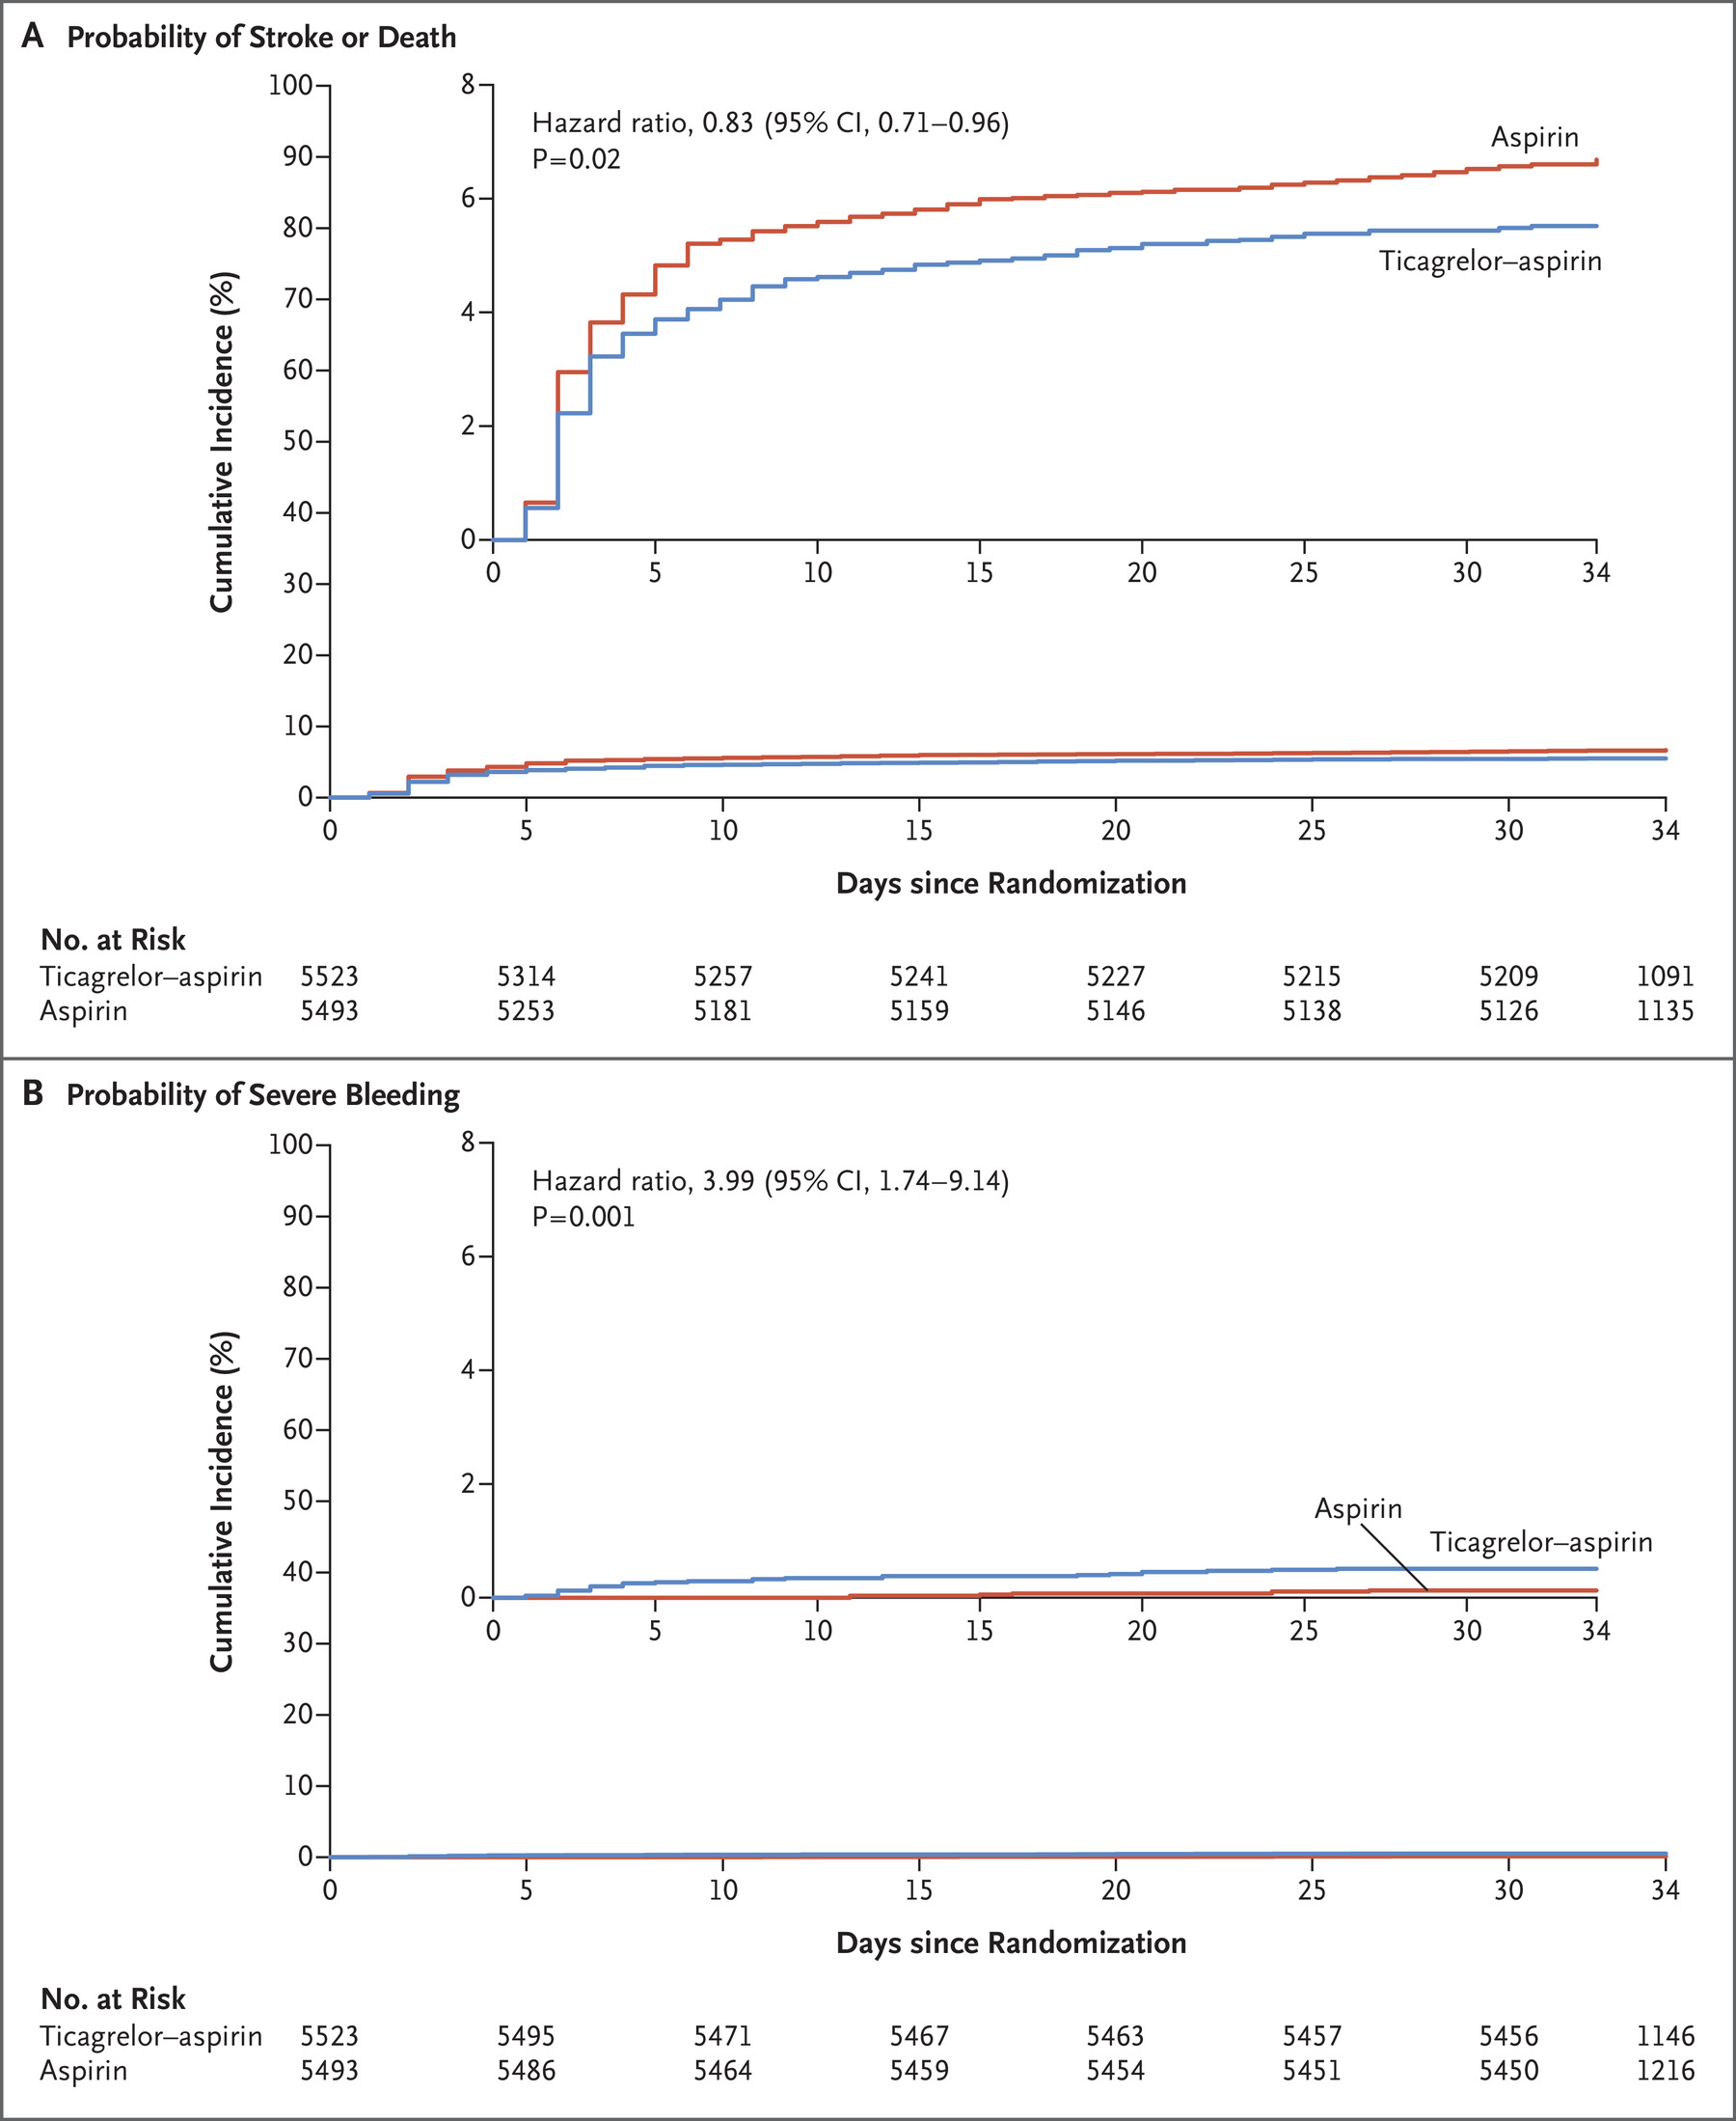

Slide 8
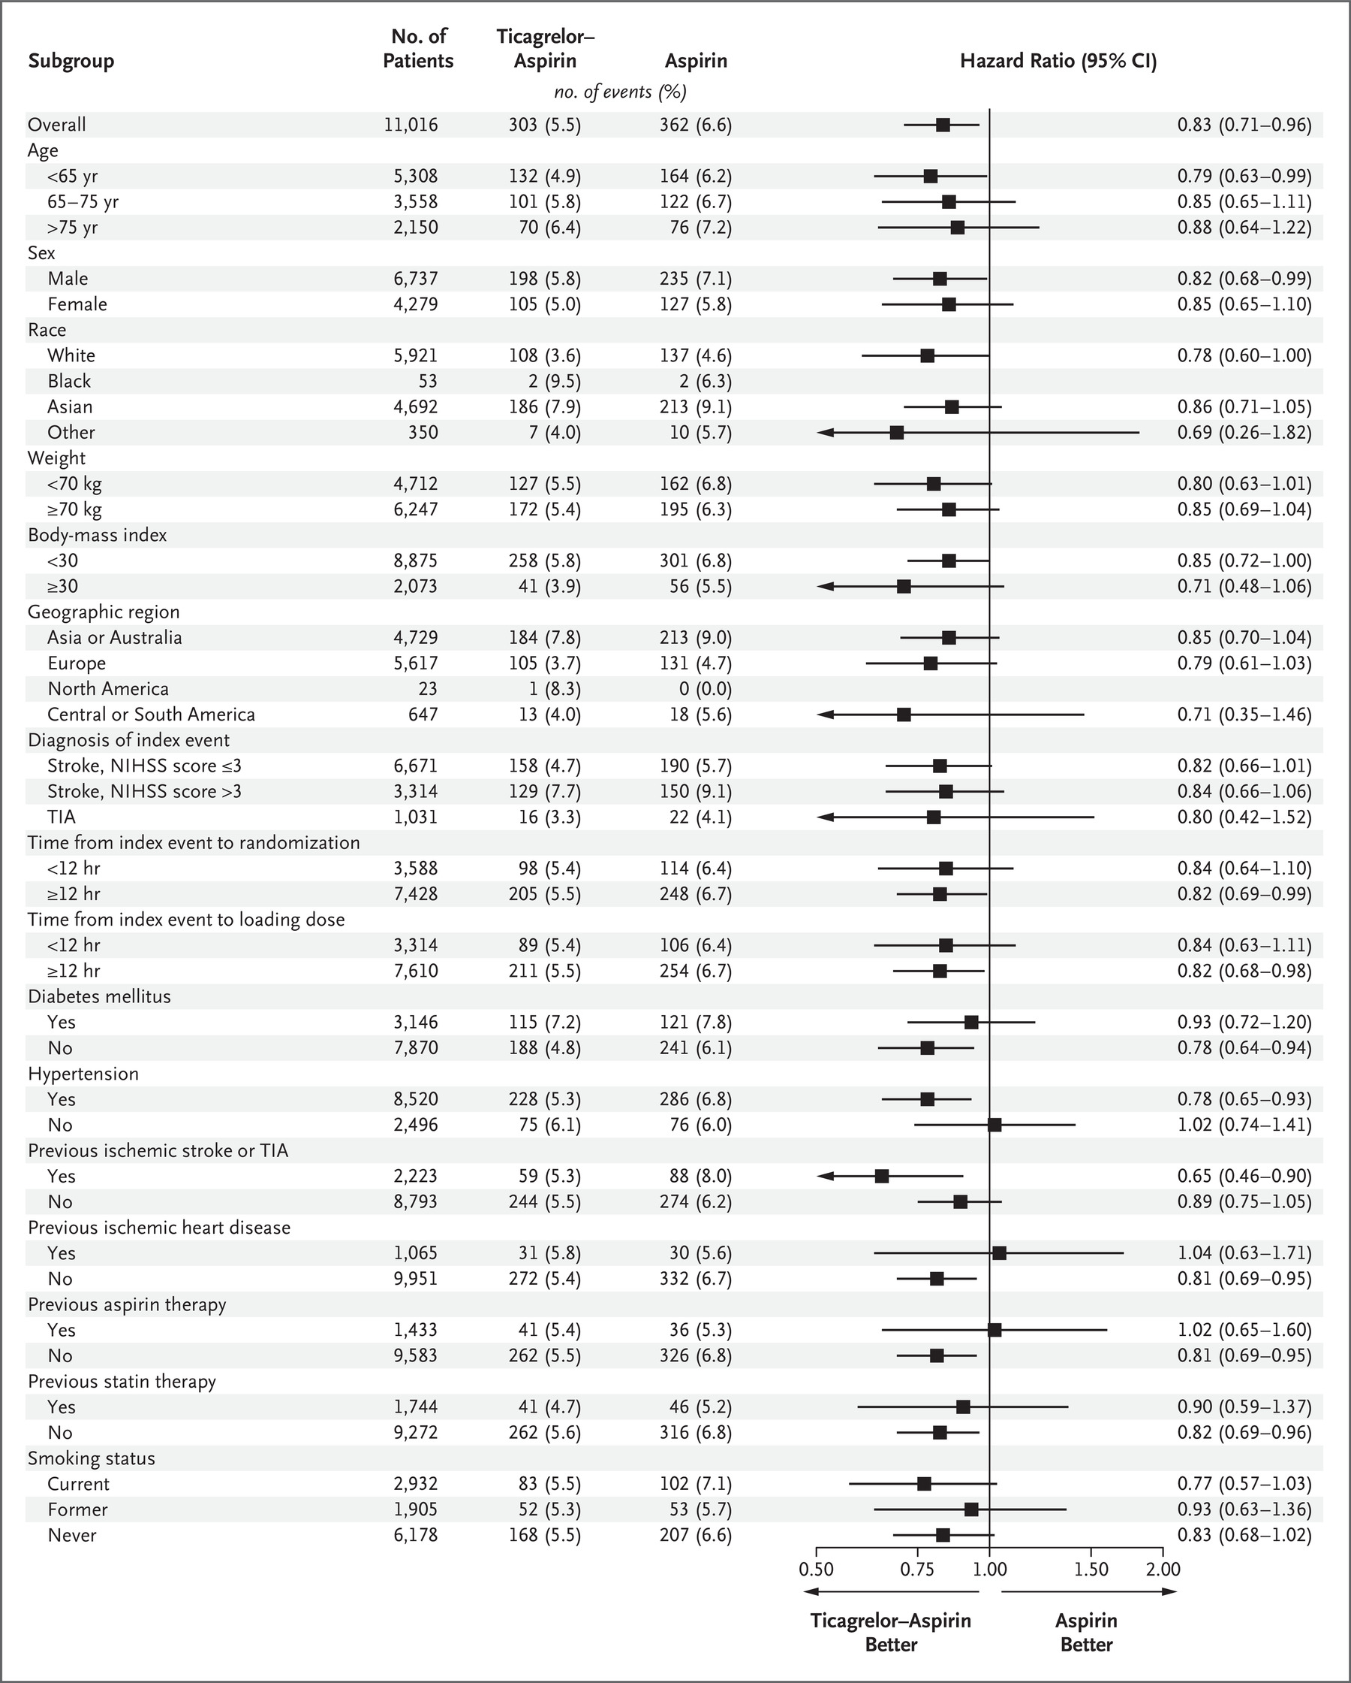

Slide 9
TICAGRELOR AND ASPIRIN OR ASPIRIN ALONE IN ACUTE ISCHEMIC STROKE OR TIA
Conclusions
The risk of the composite of stroke or death within 30 days was lower with ticagrelor-ASA than with ASA alone.
Incidence of disability did not differ significantly between the two groups.
Severe bleeding was more frequent with ticagrelor and ASA group.

Slide 10
TICAGRELOR AND ASPIRIN OR ASPIRIN ALONE IN ACUTE ISCHEMIC STROKE OR TIA
Generalizability of the results of this trial is limited by exclusion of patients:
Patients who had more severe strokes with NIHSS higher than 5
Patients with cardioembolic strokes
Patients who initiated treatment more than 24 hours after symptom onset
Patients who had thrombectomy/thrombolysis.

Slide 11
ticagrelor
Ticagrelor is an antiplatelet agent which blocks ADP (adenosine-5-diphosphate) that is not dependent on metabolic activation, reversibly binds and inhibits the P2Y₁₂ receptor on platelets.
Ticagrelor by itself did not show any benefit over ASA in preventing subsequent cardiovascular events like stroke, MI or death.
Side effects of Ticagrelor are:
Bleeding
Dyspnea
Ventricular pauses
Back pain
Dizziness
Abdominal pain, nausea, diarrhea
Rash

Slide 12
POINT STUDY
CLOPIDOGREL AND ASPIRIN IN ACUTE ISCHEMIC STROKE AND HIGH RISK TIA
JULY19,2018

Slide 13
CLOPIDOGREL AND ASPIRIN IN ACUTE ISCHEMIC STROKE AND HIGH RISK TIA
Randomized trial
Patients had minor ischemic stroke with NIHSS score of 3 or less or high risk TIA with a score of 4 or more on ABCD²
Patients were ineligible if they had isolated numbness or visual changes or vertigo or needing anticoagulation
Patients received either:
Clopidogrel at a loading dose of 600mg on day 1 followed by 75mg per day plus ASA at a dose of 50 to 325mg per day
Or they received same range of doses of ASA alone depending on the site investigator
Primary efficacy outcome was the risk of a composite of major ischemic events like stroke, MI or death at 90 days.
Primary safety outcome was risk of major hemorrhage
Secondary efficacy end points were a composite of primary efficacy outcome and major hemorrhage and the total number of ischemic and hemorrhagic strokes.

Slide 14
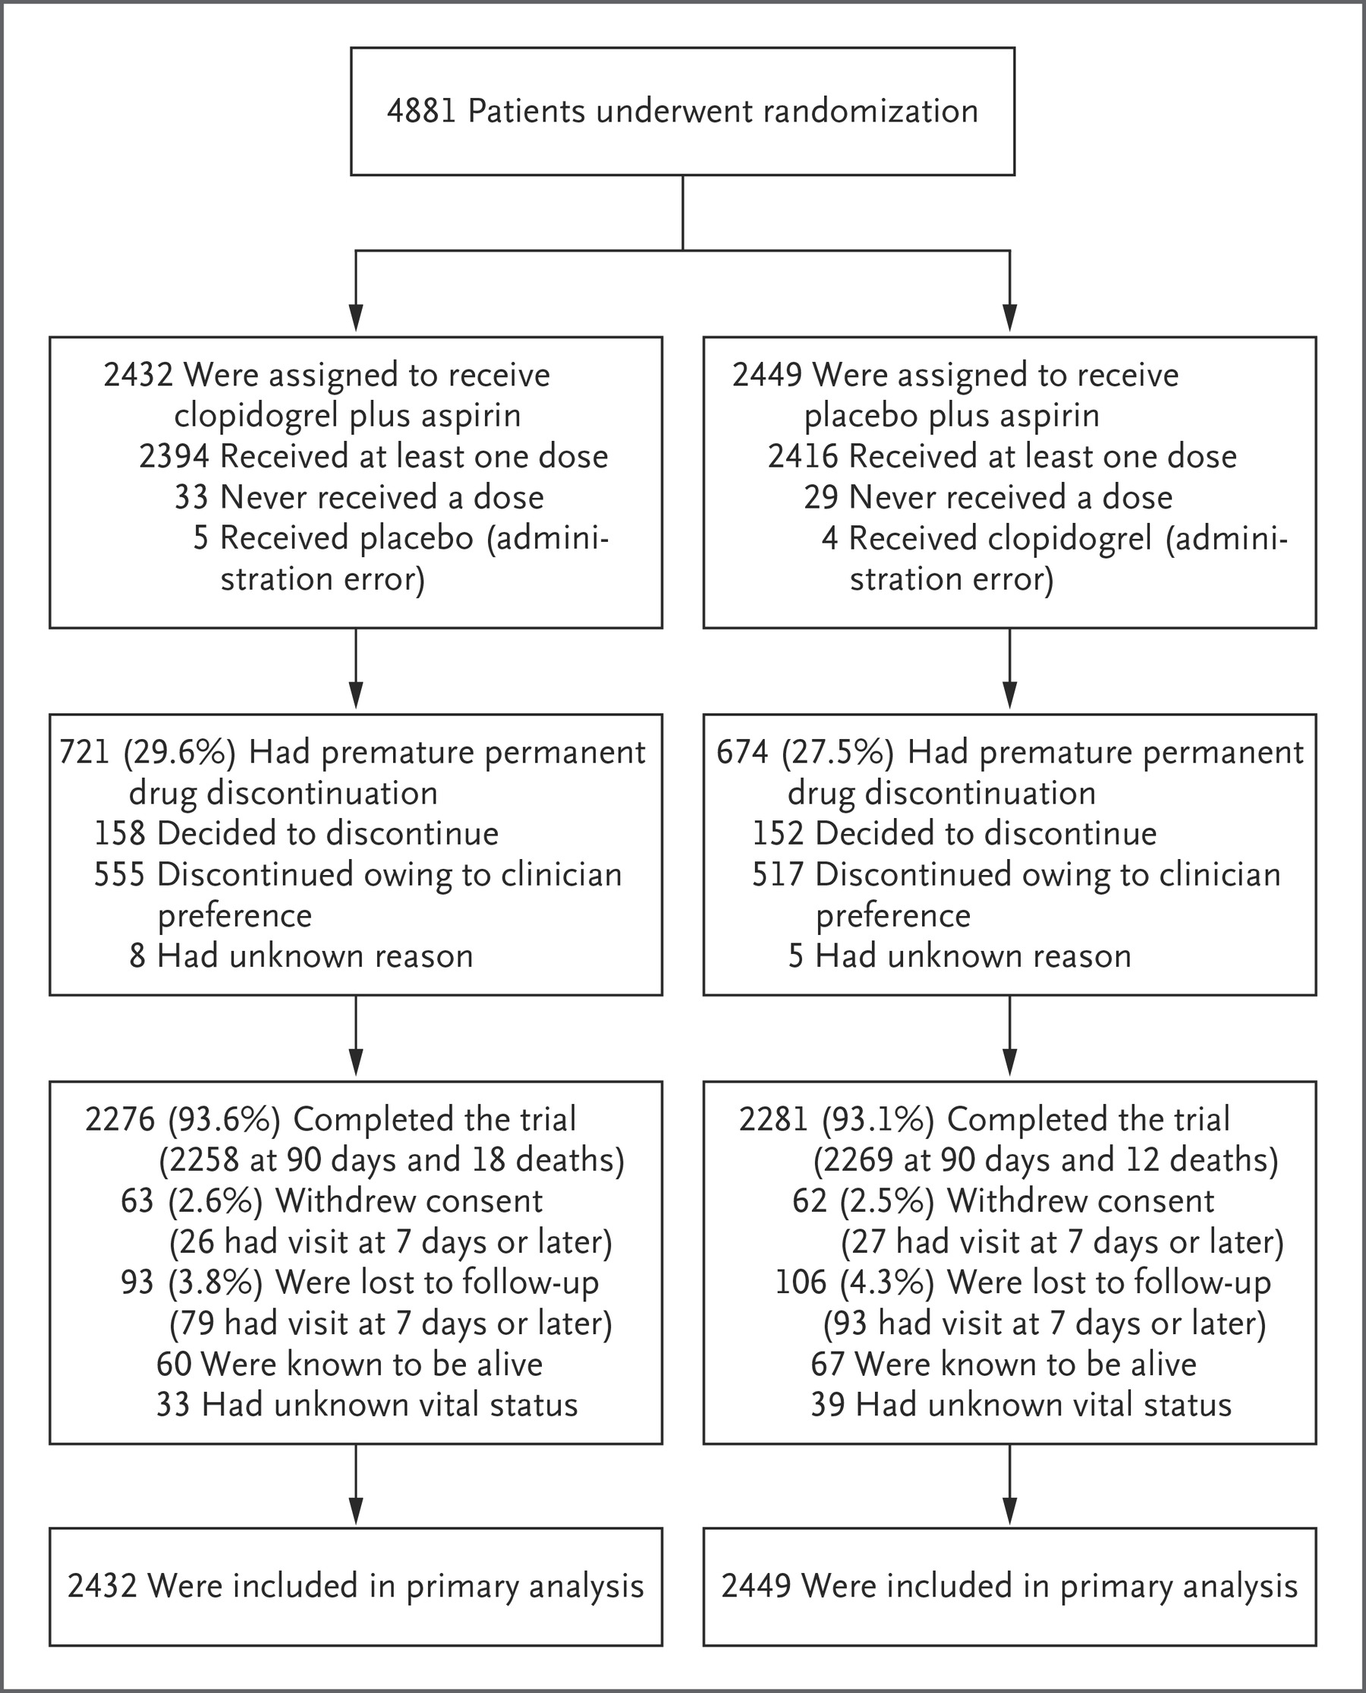

Slide 15
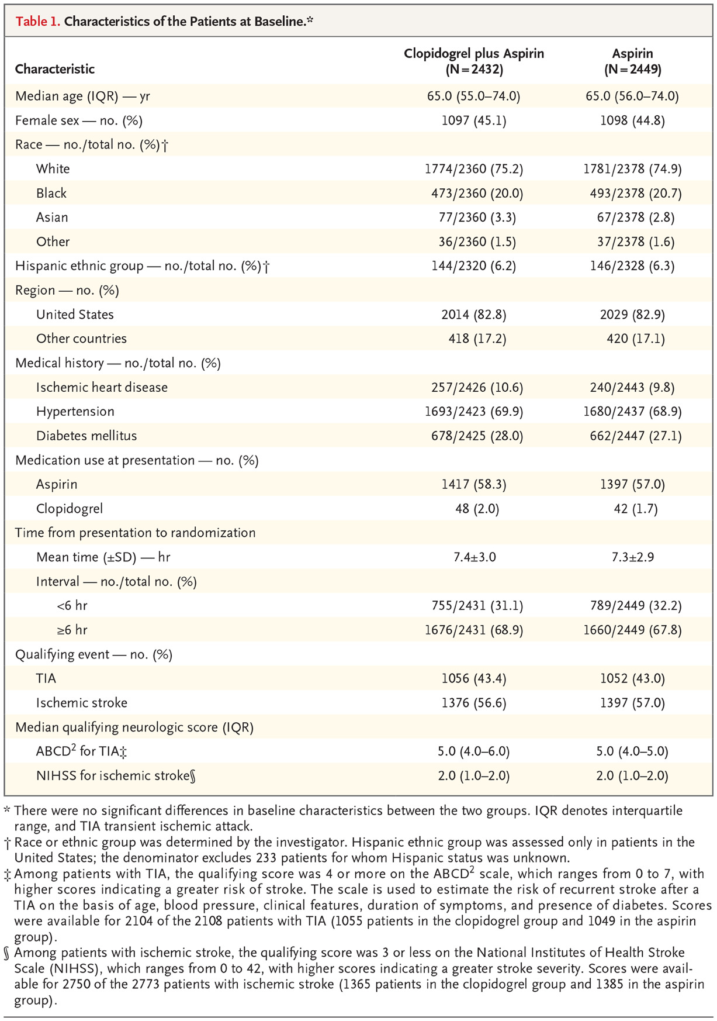

Slide 16
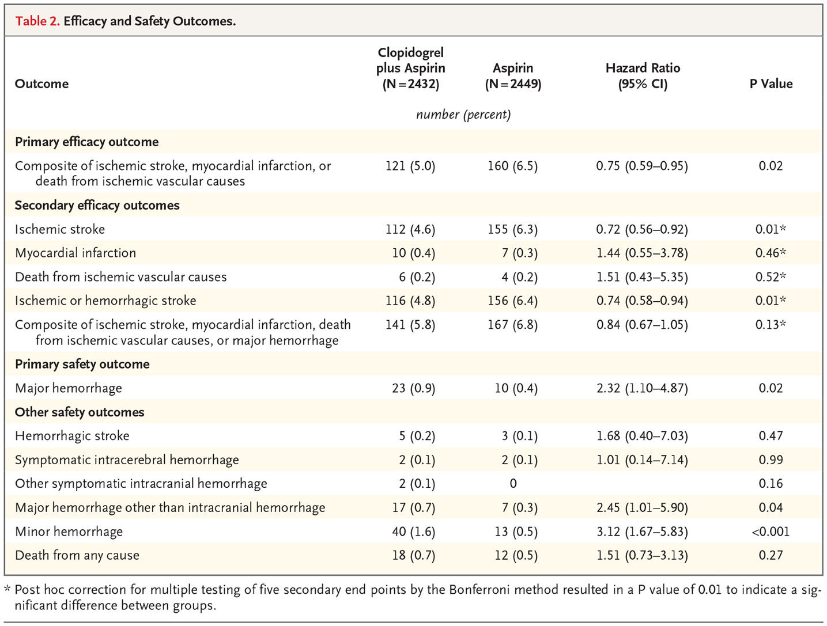

Slide 17
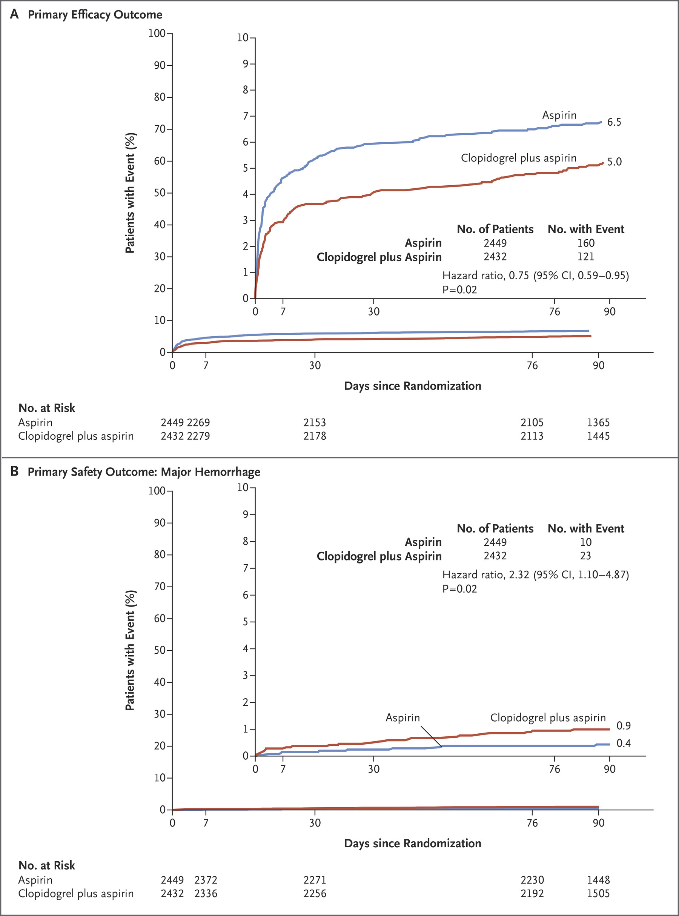

Slide 18
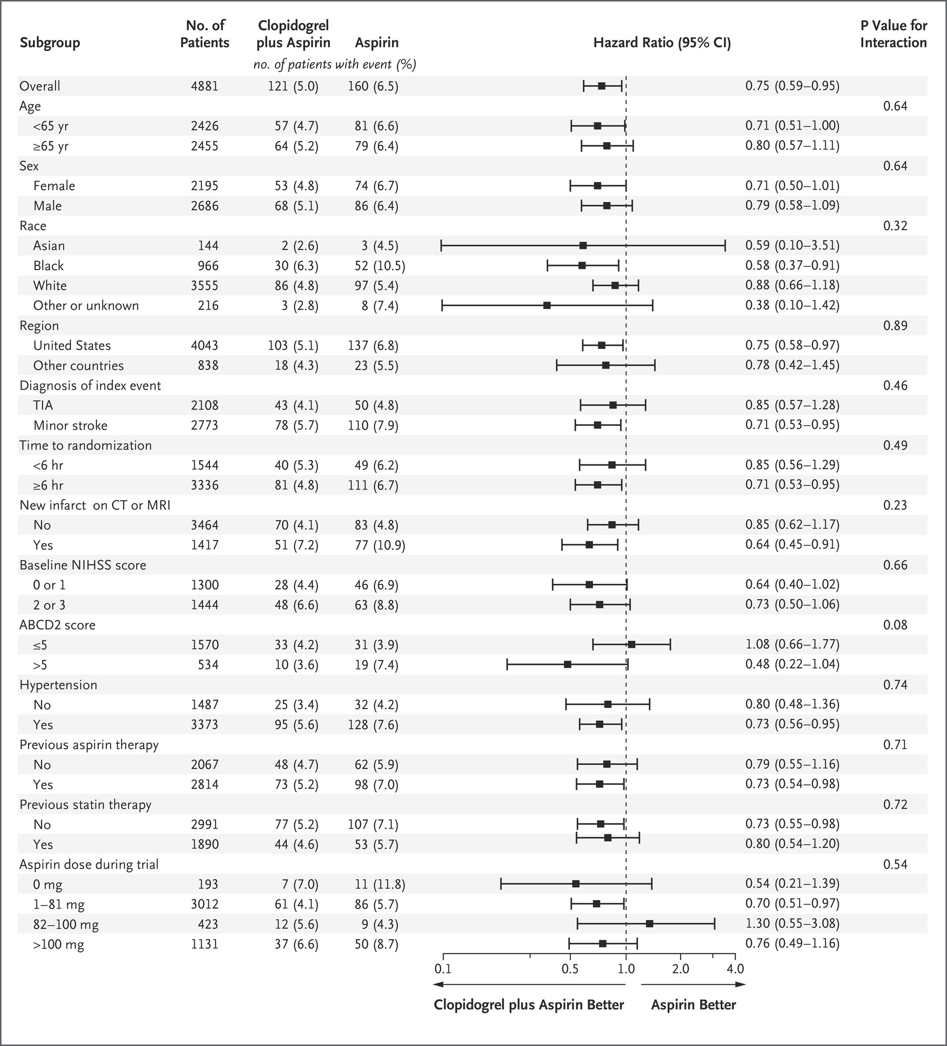

Slide 19
CLOPIDOGREL AND ASPIRIN IN ACUTE ISCHEMIC STROKE AND HIGH RISK TIA conclusions
In patients with minor ischemic stroke or high risk TIA those who received a combination of Clopidogrel and ASA had a lower risk of major ischemic events
The patients who had combination of Clopidogrel and ASA had a higher risk of major hemorrhage at 90 days than those who received ASA alone.

Slide 20
CLOPIDOGREL AND ASPIRIN IN ACUTE ISCHEMIC STROKE AND HIGH RISK TIA
The trial is limited by exclusion of:
Patients with moderate to severe stroke
Patients with cardioembolic stroke
Patients who are candidates for thrombolysis or thrombectomy
ASA dose has been varied in the 2 treatment arms so underpowered the analysis

Slide 21
clopidogrel
Clopidogrel blocks platelet aggregation through the P2Y₁₂ receptor pathway, a mechanism that is synergistic with ASA in platelet aggregation assays.
Effectiveness of Clopidogrel results from its antiplatelet activity which is dependent on its conversion to an active metabolite by the cytochrome P450 system principally CYP2C19.
It has reduced effect in patients who are homozygous for nonfunctional alleles of the CYP2C19 gene. These patients were termed as CYP2C19 poor metabolizers
People who are poor metabolizers at CYP2C19 may not respond well to clopidogrel and may fail stroke prevention.
Side effects of Clopidogrel are:
Bleeding
Abdominal pain, nausea, dyspepsia, diarrhea
Angioedema
Chest pain, hypertension
Dizziness, headache
Arthralgia, back pain
Depression
Dyspnea
Rash

Slide 22
What do we use now?
Risk of a subsequent stroke is 5-10% in the first few months. Clopidogrel and ASA has been shown to reduce the risk of stroke in CHANCE and POINT trials.
Clopidogrel needs hepatic conversion to its active form to be effective that is inefficient in 25% of white and 60% OF Asian patients so efficacy is uncertain in these patients.
Ticagrelor failed to be superior to ASA in head to head trial for prevention of subsequent ischemic strokes and the combination benefit only lasts for 30 days. After 30 days bleeding complications surpass the efficacy.
Differences in patient populations and outcome definitions prevent comparisons of the results of these trials.
Severe stroke patients or Tpa patients were excluded.

