Slide 1
EVALUATION OF CRYPTOGENIC STROKE
ILKCAN COKGOR, MD
NEUROLOGY CLINIC OF MARIN
STROKE DIRECTOR AT MARIN HEALTH CENTER

Slide 2
Definition of cryptogenic stroke
The cryptogenic stroke is defined as an ischemic stroke of undetermined etiology not attributable to a source of definite cardioembolism, large vessel atherosclerosis or small artery disease despite of extensive vascular, cardiac and serologic evaluation.
Cryptogenic strokes are associated with less mortality rate and show less neurological defects along with minor disability.
It occurs more in younger people.

Slide 3
EPIDEMIOLOGY OF STROKE
Stroke is the fifth leading cause of death in the USA.
Women have a higher life time risk of stroke than men.
Blacks and Hispanics have a higher incidence of ischemic strokes than Caucasians.
Cryptogenic stroke incidence is higher in patients under 45 years of age.
Each year approximately 795000 people are diagnosed with a new stroke.
Major types of stroke:
  Ischemic stroke accounts for 83% of the cases
  Hemorrhagic stroke accounts of 15-40% of the cases
  Cryptogenic stroke accounts for 15-40% of the ischemic stroke cases

Slide 4
STANDARD RISK FACTORS OF STROKE
Classic risk factors of stroke at any age group are:
  Hypertension
  Diabetes mellitus
  Dyslipidemia
  Tobacco use
  Heart disease like arrythmias or defective heart valves
  Obesity
  Certain medications like birth control pills
  Blood clots like deep vein thrombosis
  Illicit drugs like cocaine
  Atherosclerosis of arteries

Slide 5
Etiology of cryptogenic stroke
Cardiovascular causes:
  Transient or persistent Atrial fibrillation
  Left atrium enlargement and EKG abnormalities
  Patent foramen ovale , atrial septal aneurysm
  Valvular heart disease
    Mitral valve prolapse
    Mitral annular calcification
    Calcific aortic stenosis
    Prosthetic valve replacement
  Infective endocarditis
  Left atrial myxoma
  Left ventricular thrombus

Slide 6
Etiology of cryptogenic stroke
Noncardiovascular causes:
  Genetic disorders
  Coagulation problems or hypercoagulable state
    Protein C or S deficiency
    Factor V Leiden mutation
    Prothrombin G20210A mutation
    Antithrombin deficiency
    Antiphospholipid antibodies
  Complicated migraine
  Sleep disturbances like sleep apnea
  Infections affecting the brain
  Vasculitis and autoimmune disorders
  Noninflammatory disorders of the arterial wall

Slide 7
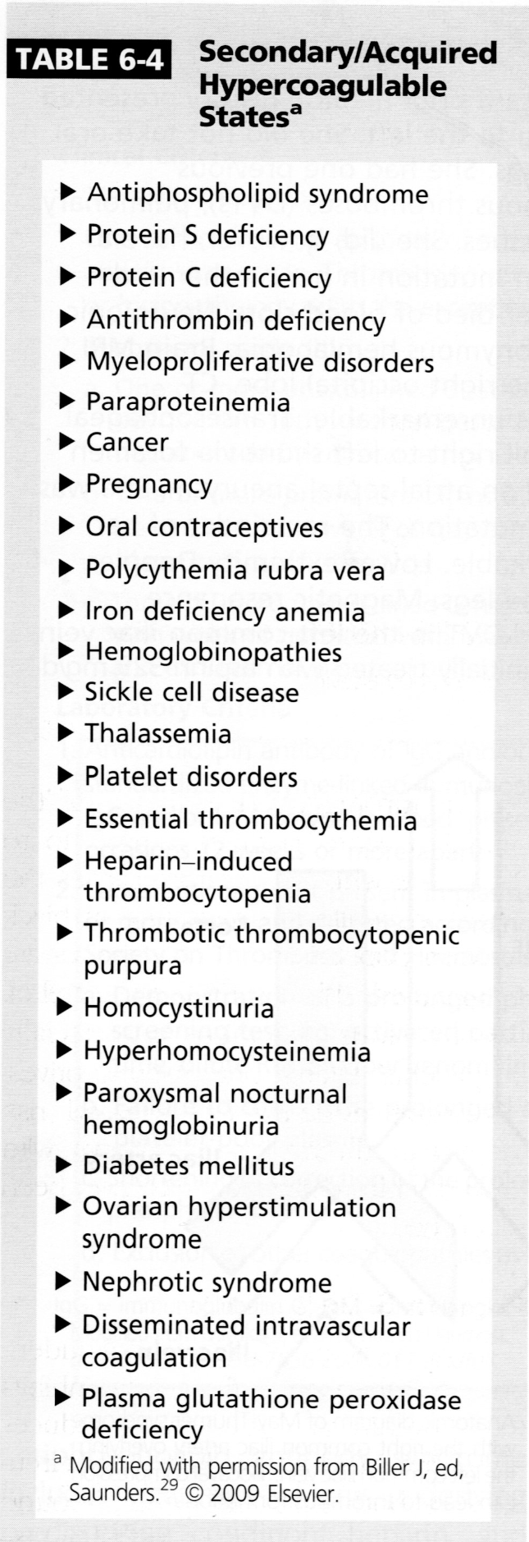
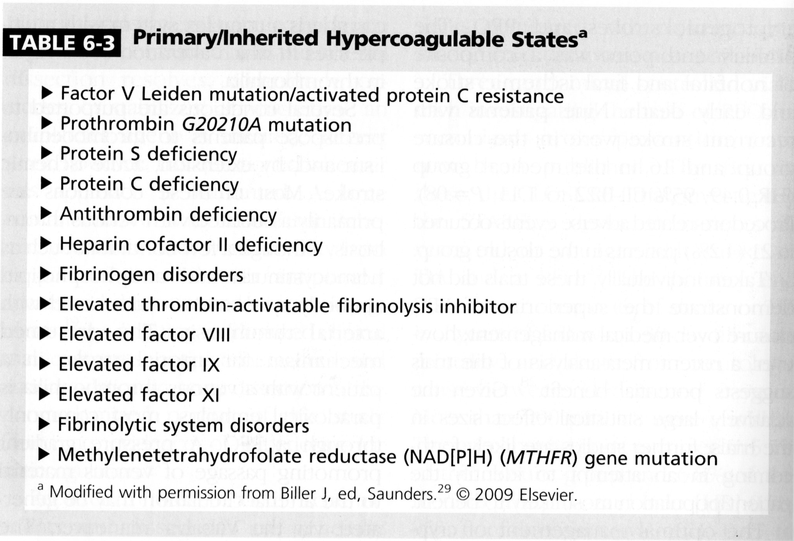

Slide 8
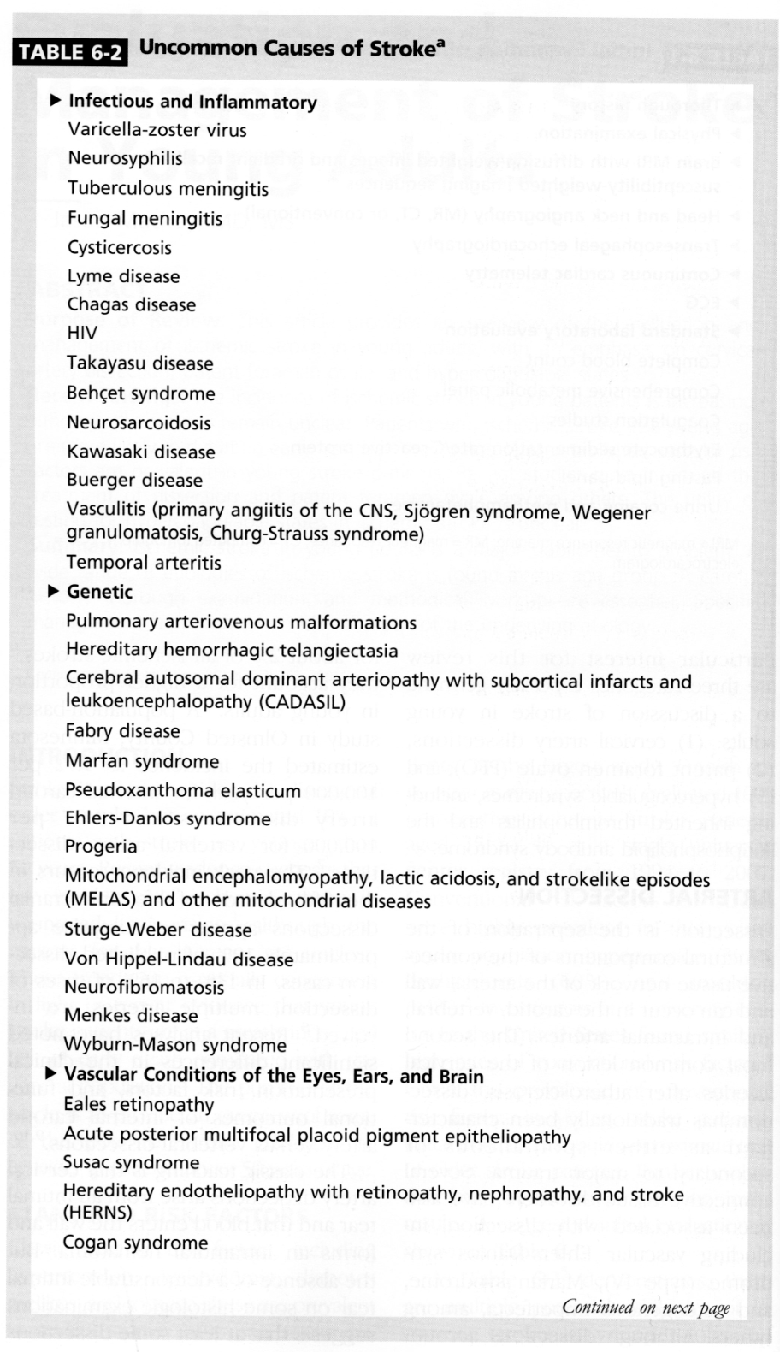
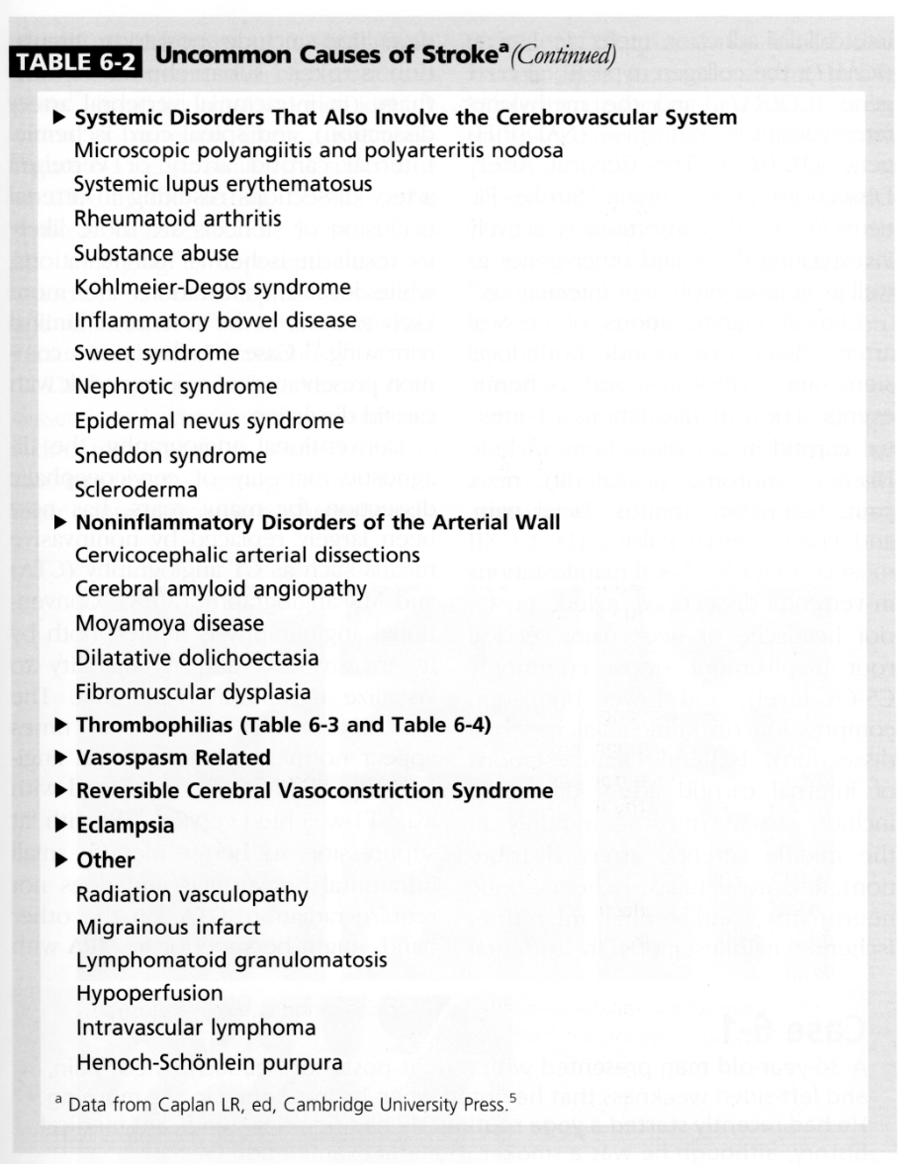

Slide 9
cryptogenic stroke symptoms
The patient may feel irregular heart beats or dumping rhythm of heartbeat.
The patient may feel discomfort at the chest or racing heart beat.
The patient may feel dizzy, faint, or vertigo.
Weight loss and night sweating may occur.
The patient may feel down or fatigued.
The patient may feel weak and numb.
The patient may feel short of breath.
Pertinent risk factors like HTN, DM, HL.

Slide 10
Work up for cryptogenic stroke
Thorough history including neck manipulation, dental or invasive procedures, IV drug use, recent pregnancy
Physical and neurological exam
MRI of brain with diffusion weighted images, gradient recall echo, susceptibility weighted imaging
CTA of brain and neck
ECG
2D echo with bubble and transesophageal echo
Continuous cardiac telemetry
Outpatient Holter monitor, Ziopatch, long term loop recorder

Slide 11
Work up for cryptogenic stroke
Blood work for genetic, autoimmune and infection causes
Standard labs:
  CBC, CMP, Lipid panel, ESR, CRP, coagulation studies, fibrinogen, homocysteine, pregnancy test
Infection labs:
  RPR, TB, HIV, Lyme titers, blood and urine cultures for fungus, virus and bacteria
Autoimmune labs:
  ANA, RF, complement levels, Sjogren panel, antiphospholipid antibodies
Urine cocaine and methamphetamine levels

Slide 12
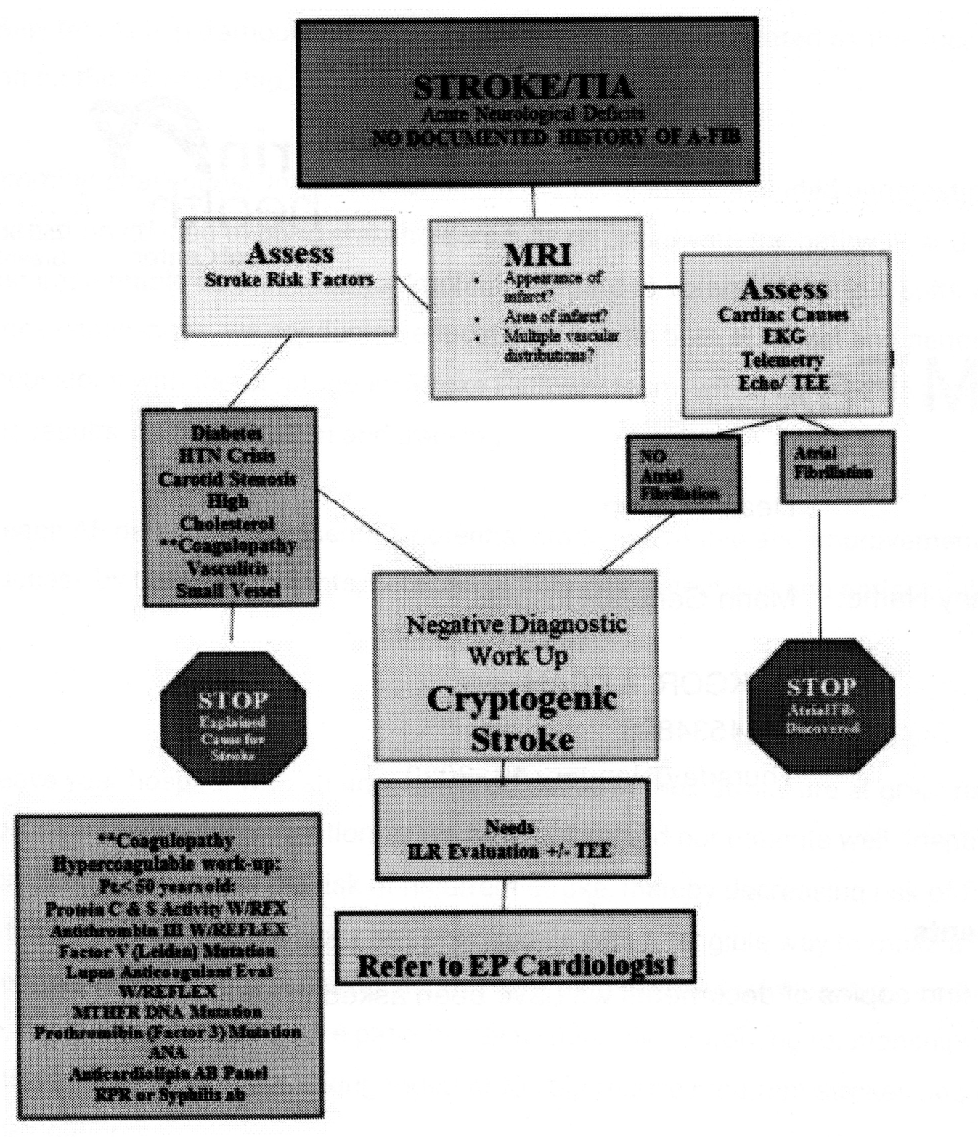
Cryptogenic str oke pathway

Slide 13
Treatment of cryptogenic stroke
If untreated the recurrence of ischemic stroke is about 1.1 to 1.6%.
The treatment depends on the etiology and risk factors.
Identifying atrial fibrillation and starting anticoagulation immediately reduces the risk of stroke.
If no definite cause identified yet antiplatelet agents like ASA and Plavix are reasonable for ischemic strokes while doing the work up.
It is vital for neurologists and cardiologists to work together as many cases are young adults and have undiagnosed arrhythmias.
We are obligated to find the cause and provide secondary prevention.

